Slide 1
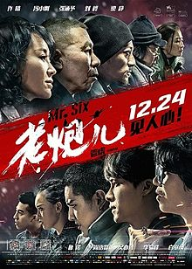
Behind Mr. Six
Film cast
Hutong
Politics
Gatsby tea talk 08/03/2016
Kevin Li

Slide 2
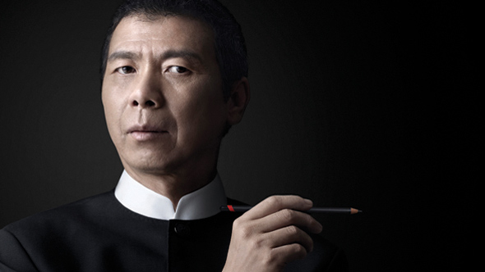
Cast – Feng Xiaogang
Top Chinese director since 1997
Started in comedy, then drama/period drama
Filmography
Assembly (2007) IMDB 7.3, Rotten Tomatoes 86%
Aftershock (2010) IMDB 7.6, Rotten Tomatoes 90%
Mr. Six (2015) IMDB 7.5, Rotten Tomatoes 71%
Notes:
1976, Tangshan, 7.8 richter scale, 650,000, victims of the earthquake. 2008, 7.9 richter scale, 69,197, 18,222
Gu and his 46 surviving men on a new assignment, which is to defend the regiment's flank, namely an old mine on the south bank of the Wen River. Liu clarifies that Gu must not retreat until he hears a bugle call for assembly

Slide 3
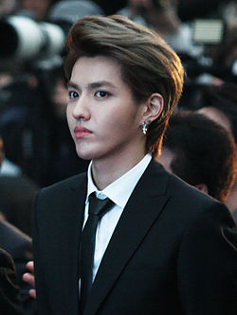
Cast – Wu Yifan (Kris)
Member of EXO
Loved by many…

Slide 4
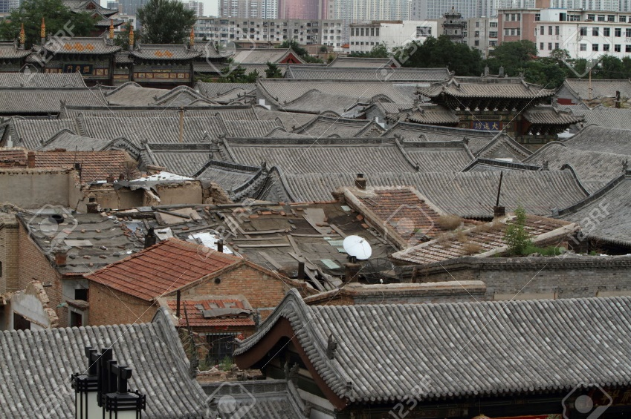
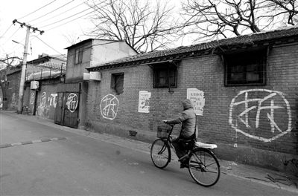
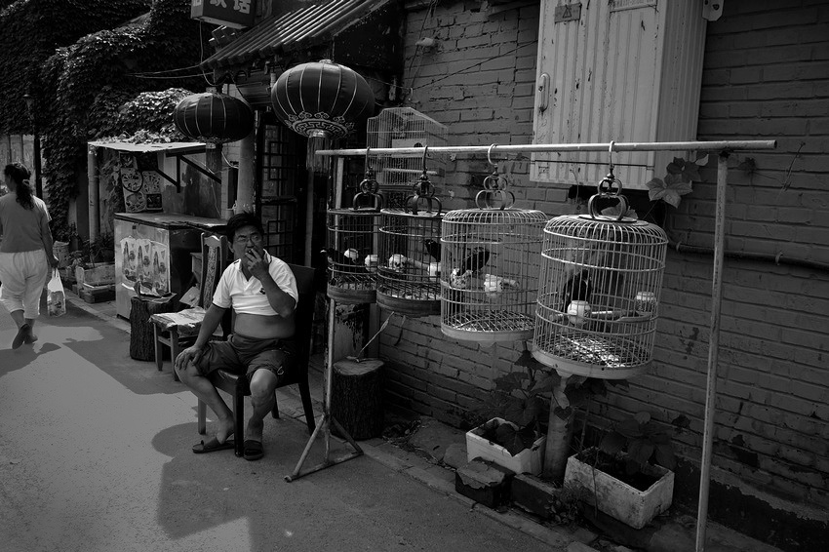
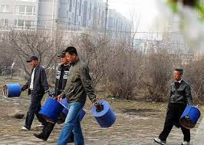
Culture – Hutong
Notes:
Like a maze
Mynah /ˈmaɪ.nə/
Recycle scrap TV, refridgerators and stuff…

Slide 5
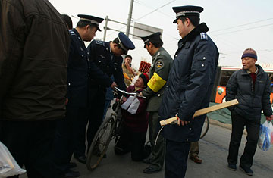
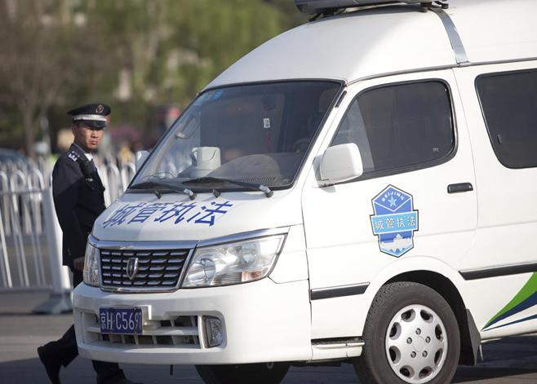
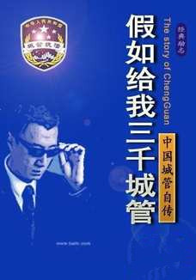
Politics – Chengguan
Urban Administrative and Law Enforcement
“China has pledged not to be the first to use Chengguan at any time or under any circumstances in order to keep world peace and stability”
Notes:
Exists in every city
Since its founding in 1997, China’s Chengguan Urban Management Law Enforcement ( 城管执法 ), a para-police agency tasked with enforcing non-criminal urban administrative regulations, has earned a reputation for excessive force and impunity.
Cui Yingjie, who killed a Chengguan in 2006 after a confrontation in Beijing.
Deng Zhengjia was a Chinese fruit vendor who was killed in a confrontation with urban management officials on 17 July 2013.
Between 2010 and 2012, Chinese media reported on over 150 violent encounters involving the chengguan forces.

Slide 6
Politics – Corruption
Somalia,
N Korea,
167
Uganda
Kenya
139
Argentina,
Ecuador
107
Thailand,
India
76
Russia
119
Sri Lanka
83
Spain
36
Israel
32
France
23
HK
18
US
16
UK
10
Denmark
1
Confucian concept of renzhi (government of the people")
Bribery, kickbacks, theft, and misspending of public funds: 3% GDP ($300bn )
As of 2015, 'netted' over 100 high-ranking officials, including about a dozen high-ranking military officers, several senior executives of state-owned companies, and four national leaders.
Ranking improvements?
More corruption
China
83
Less corruption
Notes:
as opposed to the legalist"rule of law" (法治; Fǎzhì)

Slide 7
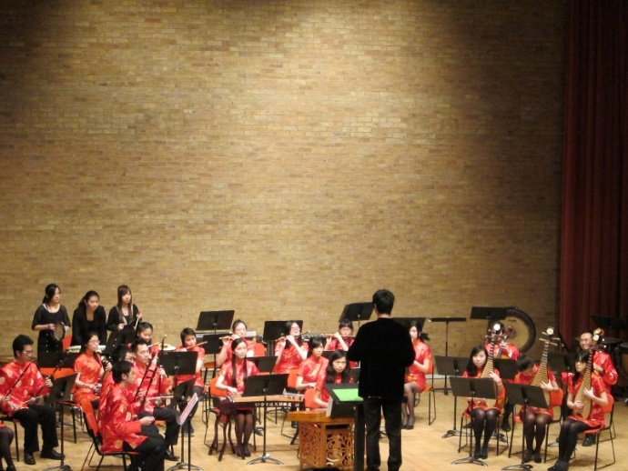
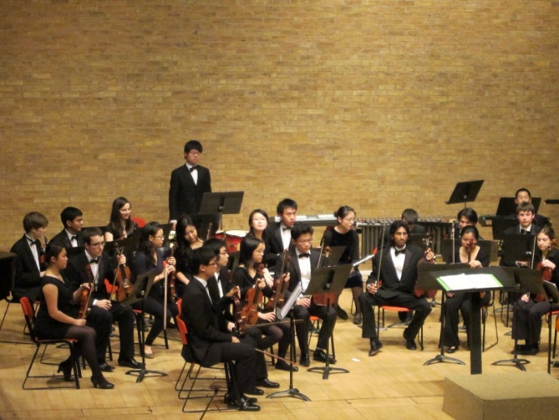
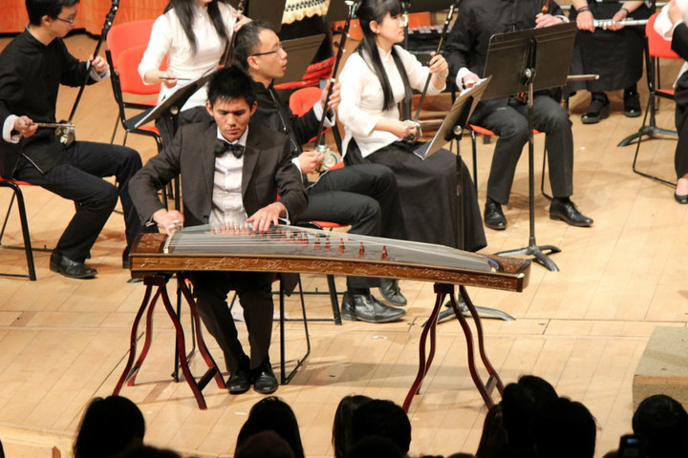
Advert…
Advert…
When: this Sunday 13th March, 7:30pm
Where: West Road Concert Hall, Cambridge
Tickets: £6.50 for students, £8.00 for standard

